Slide 1

S6 MCA PROJECT PRESENTATION

Slide 2
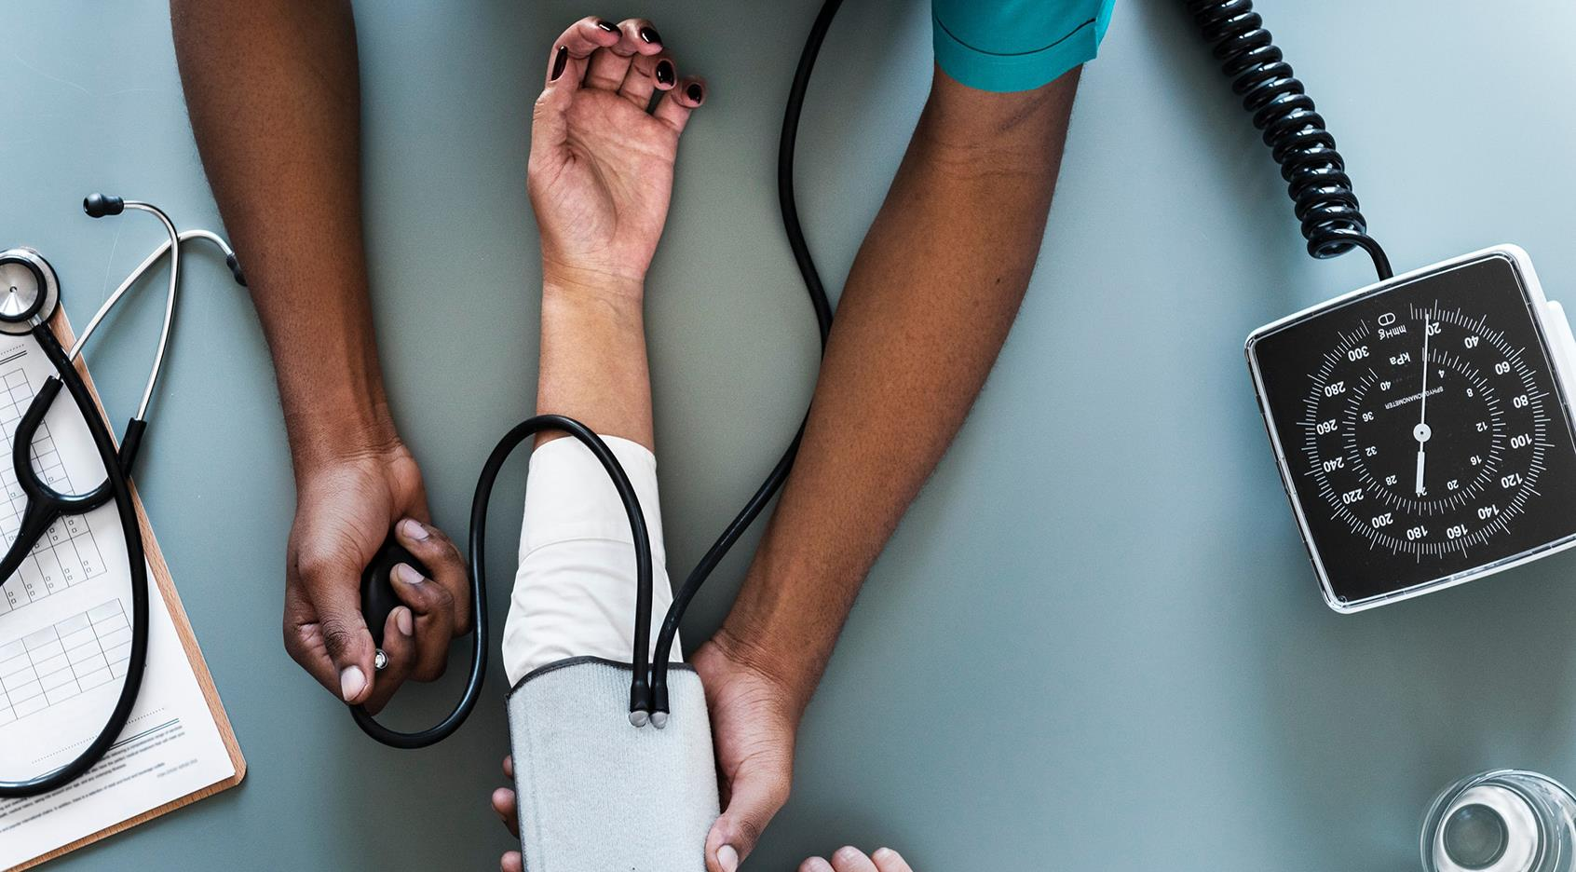
Introduction
Objectives
Existing System and drawbacks
Proposed System and advantages
Block Diagram
Steps
Hardware Requirements
Software Requirements
Conclusion
Future Enhancement
AGENDA/TOPICS

Slide 3

A SECURE IoT BASED MODERN HEALTHCARE SYSTEM USING BODY SENSOR NETWORK
Internal Guide:Prof. Anjana J
Submitted By
Lekshmi S R
LLMC17MCA020
S6 MCA,LMST

Slide 4
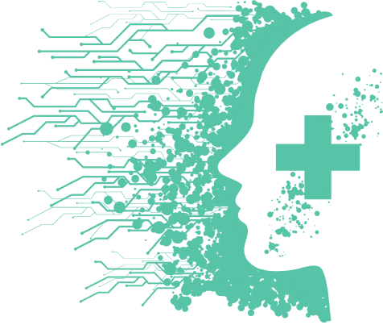
INTRODUCTION
In the present-day scenario, we find a large number of elderly people staying alone in flats or at isolated places. Recent research indicates that about 80% of aged people above the age of 65 are suffering from at least one chronic life style disease.
IOT based modern healthcare is intended to meet the urgent medical needs of patients particularly isolated senior citizens. The proposed modern IOT based BSN care envisages provision of affordable and timely healthcare at their door step and thus improving the quality of life.

Slide 5
OBJECTIVES & SCOPE
IOT based modern healthcare is primarily intented to take care of the health aspects of older people staying alone. The system envisages to real time monitoring of the health parameters of dependent patients and provide timely and quality healthcare to them.
Objective of the project is to make affordable, fully secure and timely healthcare to the dependent patients. The system make use of Body sensor network which with the help of iot and internet measures and forward the health parameters of patients on real time.
The patients data base is passed on to designated family member/friend on real time by Blynk/cloud server through mobile network who then take appropriate action to save the patient.

Slide 6
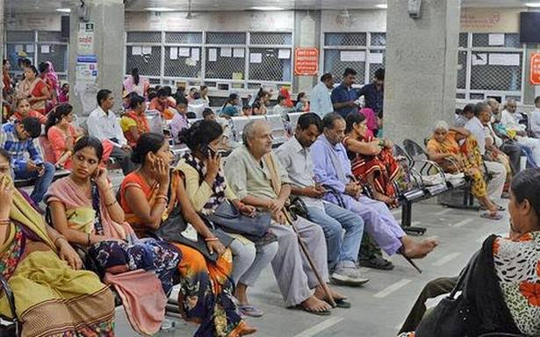
EXISTING SYSTEM
Existing medical care is manual as a patient has to physically go to a doctor/hospital for treatment. In most of the cases a patient has to wait in queue for long time to get consultation/medicine. This becomes very difficult for senior citizen and emergency cases as travel and waiting is involved before getting treatment. The present system is expensive and time and effort consuming.

Slide 7
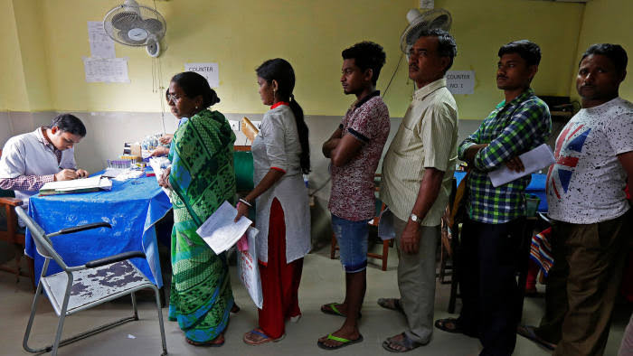
DRAWBACKS OF EXISTING SYSTEM
Existing System is inefficient.
It is very tedious and time consuming.
Lack of safety and security.
Complexity.
More human efforts.
Implementation Issues.
High Expenses.

Slide 8
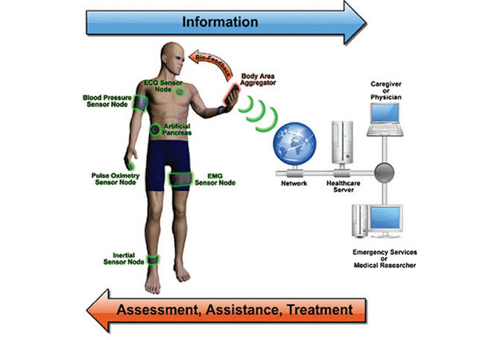
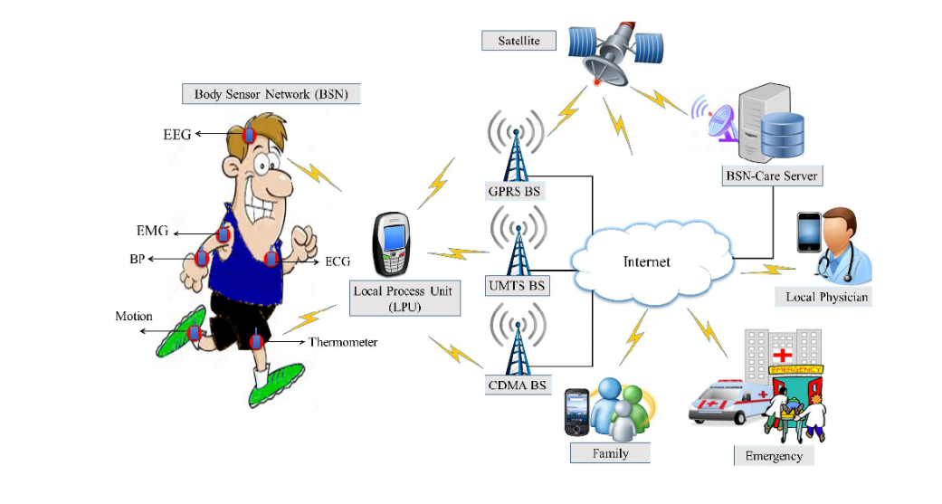

Slide 9
PROPOSED SYSTEM
The proposed system is meant to provide quality and affordable healthcare to all patients on real time by taking advantage of most modern technologies like bio-sensors, IOT & mobile network.The system when fully developed and integrated will be available world wide.

Slide 10
ADVANTAGES OF PROPOSED SYSTEM
Real time monitoring of health parameter.
System is safe and secure.
User Friendly.
Chronic disorders identified at primary stage itself by doctors for better decision making.
Future expansion is possible.

Slide 11
BLOCK DIAGRAM
when integrated with healthcare provider
Blocks inside the dotted line will be applicable when connected healthcare provider
Caregiver or physicians
Temperature Sensor
B
NodeMCU
Healthcare server
Heart beat pulse sensor Amped
Upload sensor data to Thingspeak Using NODE MCU
Emergency Services or Medical Researcher
Pulse Rate
Family or friend
Oxygen Level

Slide 12
STEPS
Sensors output of the sensors worn by the patient namely Temperature sensor, Heart beat pulse sensor, oxygen level and pulse rate sensor are fed to the NODE MCU.
These sensor data is uploaded to Thingspeak using NODE MCU. Blynk server then forward the coded data to family member or friend and to healthcare server when integrated.
The data so received is analysed and interpreted by the healthcare server when fully developed who takes timely action. In this case the family member or friend who is connected to sensor output should be capable of taking necessary action on receipt of sensor data or alert notification on the mobile network or Email.

Slide 13
STEPS
In case of up normal readings of pulse rate, temperature and oxygen level a led light on patients wrist band will glow and simultaneously an alarm will be sounded. This is a caution to the patient and family members who stays with him who can take appropriate action.
Friend of the patient also get a Blynk notification on mobile and a message on Email. The same information will also be available on Thingspeak of the mobile of friend or caregiver.
The medical data base of the patient will be stored for a year by the Thingspeak which can be seen when required.

Slide 14
UML DIAGRAM BSN Health Care
Initialize Sensors
Read Temperature
Count pulse rate
Find oxygen level
Create Data base
Initiate Emergency Alert
Save History for 1 Year
Alarm LED To patient/family
Email Notification To friend/care taker

Slide 15
Requirements
NodeMCU
Hardware
DHT 11 Temperature Sensor
Heart beat pulse sensor Amped
Requirements

Slide 16
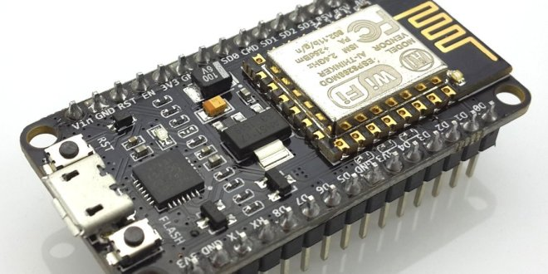
NodeMCU
NodeMCU is a nano chip on the wrist band to which other sensors are also connected sensors feed their output to the nano chip which convert them to digital signal and is fed to the cloud server application. ESP 8266 NodeMCU is used in the project.NodeMCU is an open source development board and firmware based in the widely used ESP8266 -12E WiFi module. It allows you to program the ESP8266 WiFi module with the simple and powerful LUA programming language or Arduino IDE.

Slide 17
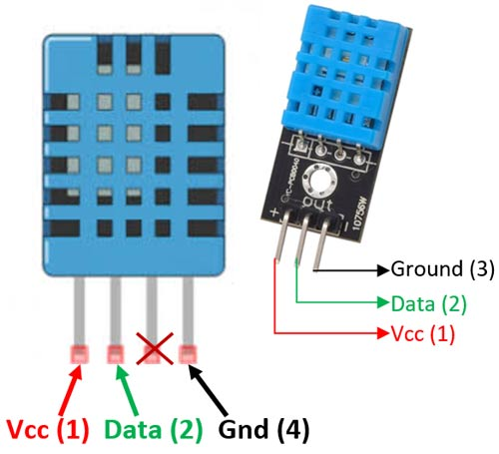
DHT 11 Temperature Sensor
The DHT11 is a commonly used Temperature and humidity sensor. The sensor comes with a dedicated NTC to measure temperature and an 8-bit microcontroller to output the values of temperature and humidity as serial data. The sensor is also factory calibrated and hence easy to interface with other microcontrollers.DHT11 is a low-cost digital sensor for sensing temperature and humidity. This sensor can be easily interfaced with any micro-controller such as Arduino, Raspberry Pi etc… to measure humidity and temperature instantaneously.
DHT11 Specifications
Operating Voltage: 3.5V to 5.5V
Operating current: 0.3mA (measuring) 60uA (standby)
Output: Serial data
Temperature Range: 0°C to 50°C
Humidity Range: 20% to 90%
Resolution: Temperature and Humidity both are 16-bit
Accuracy: ±1°C and ±1%

Slide 18
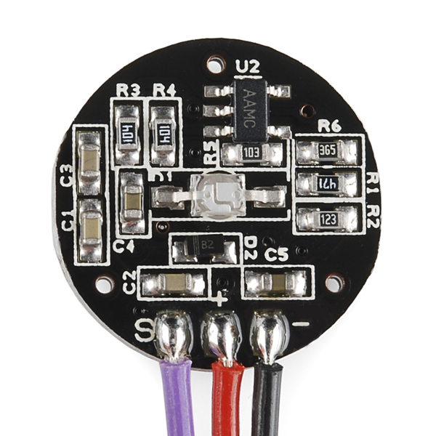
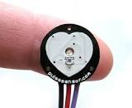
Heart beat pulse sensor Amped
Heart rate pulse sensor amped is a such type of sensor which is mainly used for sensing heartbeat rate. Normally it is very difficult task to measure the exact heartbeat rate, but this have become so much easy with the help of this pulse sensor amped. If we talk about heartbeat, then heart beat is a periodic signal that is produced by any software or hardware system for giving intimation to normal of working of any system. For measuring this periodic intimation signal, so many sensors have been using currently in market but here we shell only talk about pulse sensor amped.

Slide 19
Requirements
Operating System:Windows 7
Software
Front End:Arduino IDE
Server/Database:Thingspeak & Blynk
Requirements

Slide 20
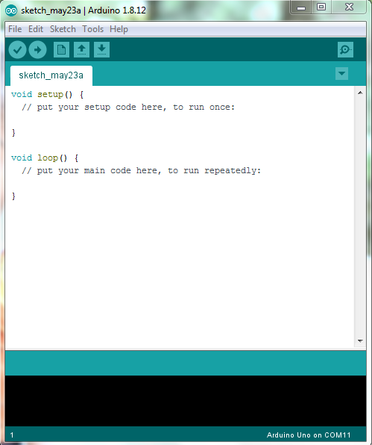
Arduino IDE
Arduino is an open-source electronics platform based on easy-to-use hardware and software. The Arduino Integrated Development Environment (IDE) is a cross-platform application that is written in functions from C and C++. It is used to write and upload programs to Arduino compatible boards, but also, with the help of 3rd party cores, other vendor development boards.

Slide 21
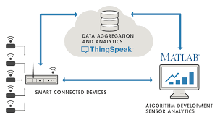

Thingspeak
Thingspeak is an IoT analytics platform service that allows you to aggregate, visualize and analyze live data streams in the cloud. Thingspeak provides instant visualizations of data posted by your devices to Thingspeak.
Thingspeak key Features:
Easily configure devices to send data to Thingspeak using popular IoT protocols.
Visualize your sensor data in real-time.
Aggregate data on-demand from third-party sources.
Use the power of MATLAB to make sense of your IoT data.
Run your IoT analytics automatically based on schedules or events.

Slide 22
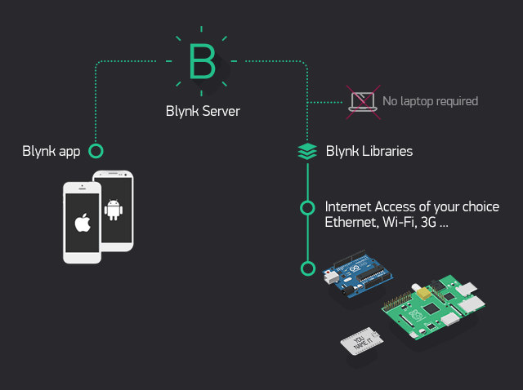
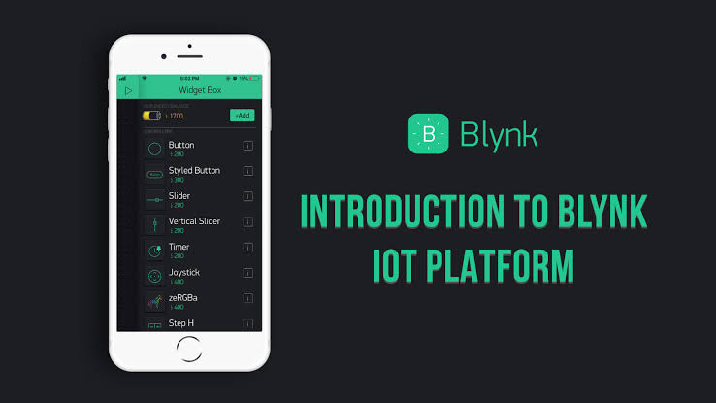
BLYNK APPLICATION
Open Source Android App (Blynk)-: Blynk is an open source android app which is designed and developed in order to control the hardware via internet of things (IOT). This digitally displays sensor data, it can accumulate and visualize the data. Plus, it can also do other parameters such as:
Blynk Libraries: For all the standard hardware platforms, supports communication with the sensor and the complete progression of incoming and outgoing instructions.

Slide 23

CONCLUSION
IOT based BSN-CARE healthcare system is undoubtedly going to revolutionize the existing conventional healthcare practices of the world. Formation of long queues in hospitals and in front of renowned doctors for specialist consultation etc. will soon be a thing of the past. Modern IOT based BSN healthcare system envisages provision of quality and timely healthcare at your door step based on data received on real time at the exclusive healthcare network. More over global consultation of expert renowned specialist doctors will be just a click away when fully developed worldwide.Further BSN healthcare will be a boon to slum dwellers as quality and affordable treatment can be provided to them on real time at their door step. BSN healthcare is the ideal way of treatment for all during spread of pandemic like corona virus.

Slide 24

FUTURE ENHANCEMENT
The system can be enhanced to cover in remote villages where IOT can be gainfully utilised. Body sensors in due course of time will be employing most modern technologies to minimise or make the radiations negligible. Since internet and mobile network has conquered the whole world making the whole world a global village IOT based BSN healthcare can be extended to benefit the whole global population. IOT based BSN healthcare will revolutise the field of medical care in due course of time benefitting the whole world. Once fully developed and fully integrated consultation of an expert specialist anywhere in the world will be just a click away from you.

Slide 25

Thank You

